Slide 1
ACCESS CM-2 with CABLE
Martin Dix CSIRO Oceans and Atmosphere

Slide 2
Recent simulations
AMIP runs
  ACCESS1.4 like options
  “Conservative” options
  New science
Coupled PI control run with “conservative” options
  Based on JULES experiment u-at658. Started from year 200
No carbon cycle experiments planned for CMIP6

Slide 3
New CABLE science & fixes
New science
  fwsoil_switch='Haverd2013
  gs_switch='leuning' ('medyln' also tested)
  gw_model=.false. Strange results when tested
  or_evap=.false. Soil pore physics
Coupling improvements and fixes
  l_rev_corr=.true.
  l_revised_coupling=.true.
  soil_thermal_fix=.true.

Slide 4
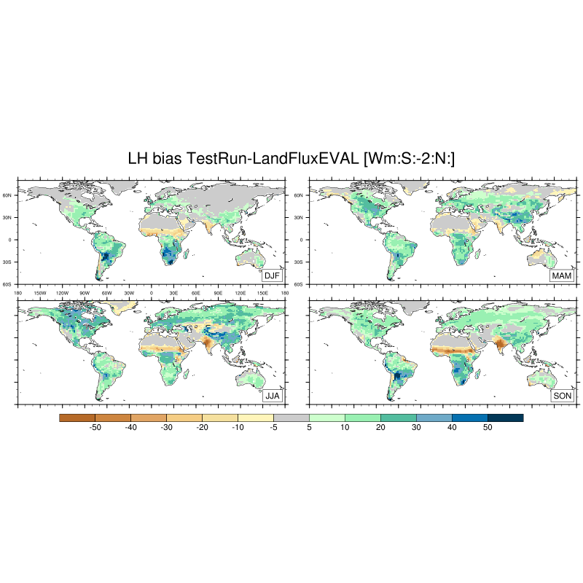
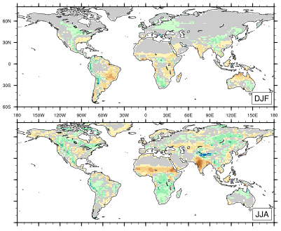
Latent heat relative to LandFlux data 1990-2005
Standard
or_evap

Slide 5
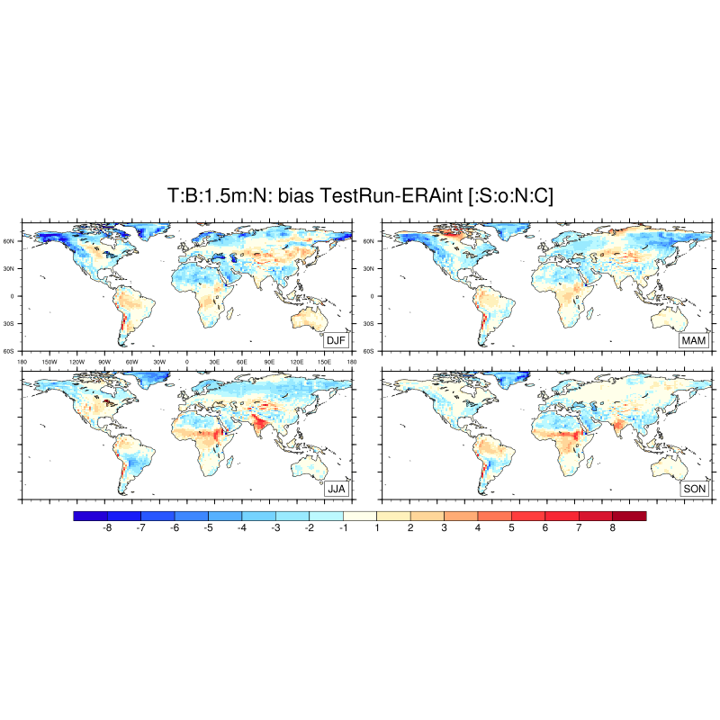
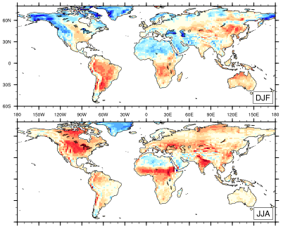
Screen temperature bias relative to ERAint 1988-2011
Standard
or_evap

Slide 6
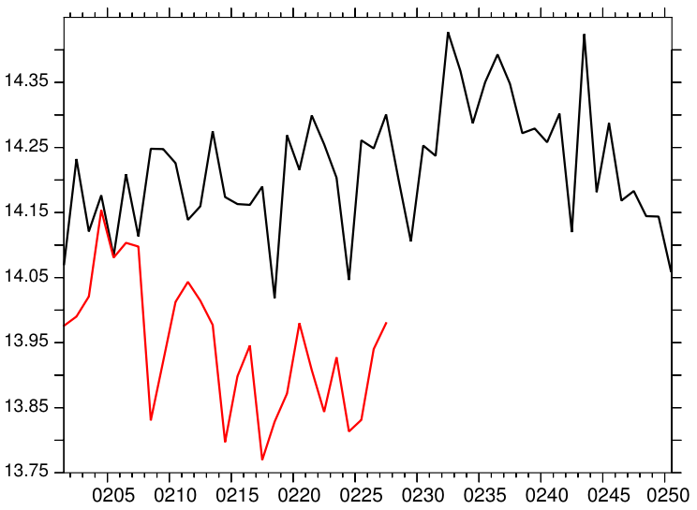
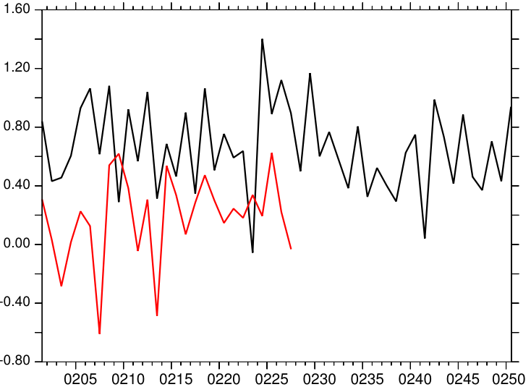
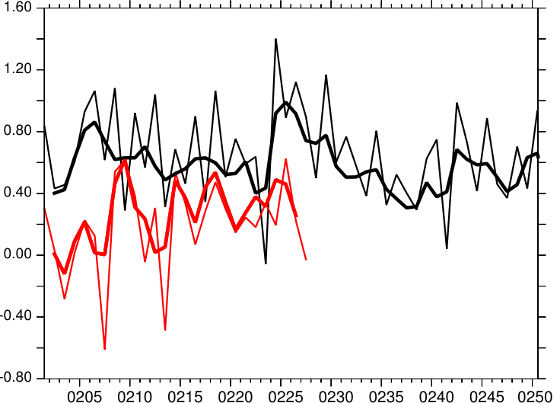
Coupled model results
Global annual mean surface temperature
Net TOA energy flux and change in ocean heat content
Net TOA energy flux
W m⁻²
ºC
JULES
CABLE
JULES
CABLE
JULES
CABLE
Model year
Model year

Slide 7
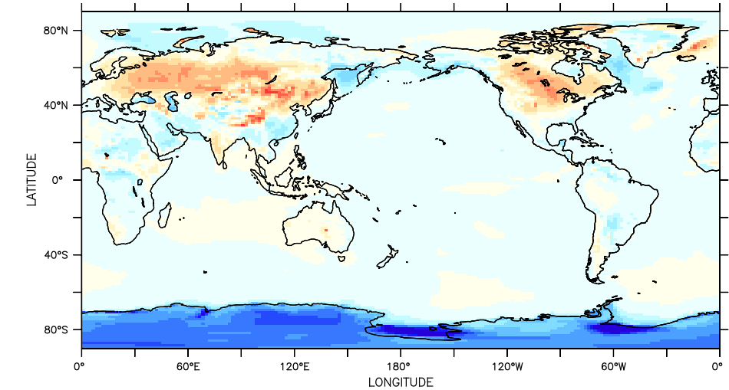
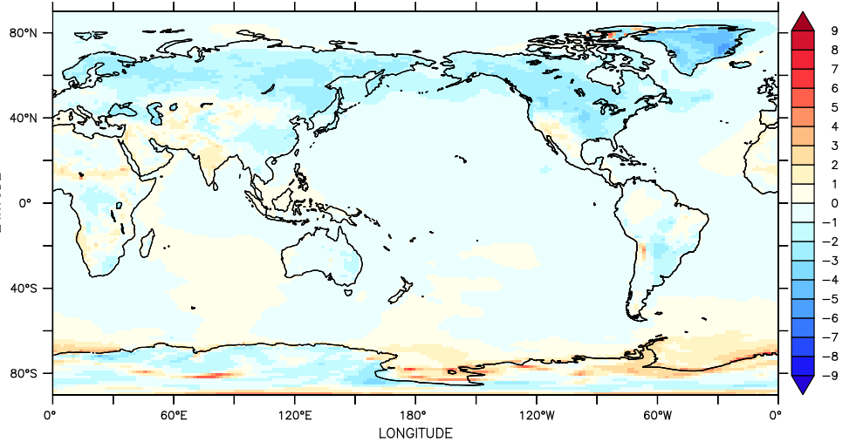
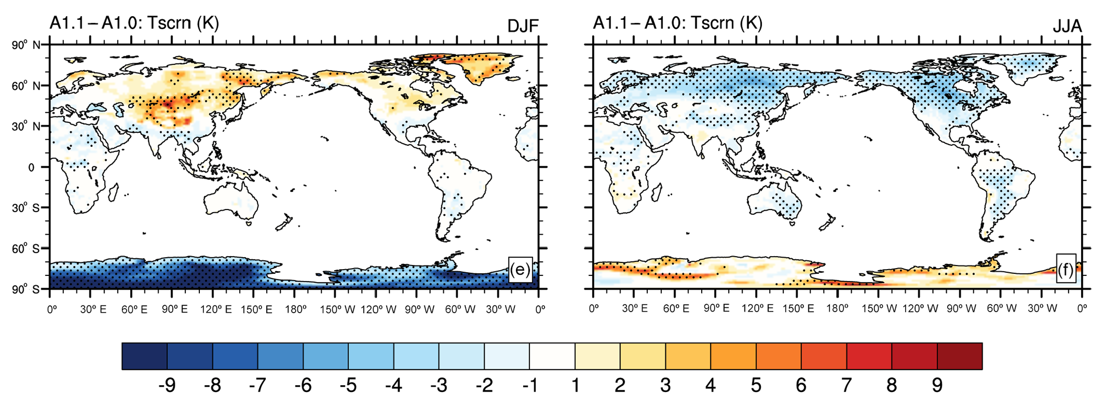
CABLE – JULES DJF
CABLE – JULES JJA

Slide 8
Martin Dix: martin.dix@csiro.au

